Slide 1
Dentition in mammals
Dr Lt Santhosh S
Asst Professor
PG Department of Zoology

Slide 2
Dentition : the arrangement of teeth in upper and lower jaw
Most specialized in mammals
Teeth present in all mammals except in Platypus & Whale bone whales (teeth absent in adult condition)

Slide 3
Teeth present in all mammals except the following
Platypus
Embryonic teeth are replaced in adult by horny epidermal plates for crushing molluscs
Whale –bone whales
Foetal teeth are replaced in adult by baleen plates for straining the planktonic food
Ant-eaters
Teeth not present even in early stages

Slide 4
Importance of dentition study
Helps in tracing evolution
Helps in classification
Gives an idea of approximate age of the mammal
Provides clue to the diet of mammal

Slide 5
Structure of tooth
In mammals – tooth is firmly fixed in a socket in the jaw-bone, hence called thecodont
Some portion lie within jaw-bone & some portion lies outside it.
Typical mammalian tooth has 3 regions – a crown, a root & a short neck between them
Tooth is made up of dentine, & coated with enamel on the crown & with cement in the root.
Gum covers neck region
Pulp cavity inside tooth with gelatinous connective tissue or pulp containing blood vessels and nerves
In incisors of elephants and rodents, pulp cavity remains open basally so that teeth continue growing throughout life and termed open rooted
In other mammals, pulp cavity becomes closed at a certain age so that nourishment stops and further growth stops : close- rooted

Slide 6
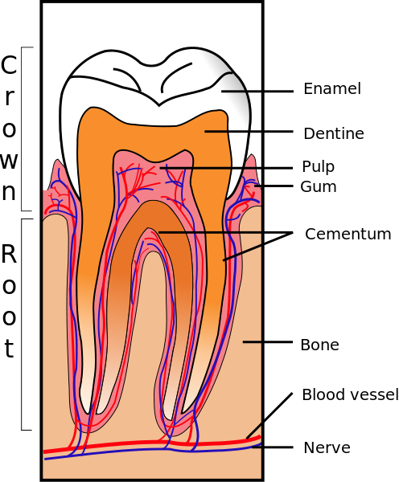

Slide 7
Development of tooth
Tooth arises as the dermal or dental papilla on jaws
Outer columnar cells differentiate into odontoblasts which secrete a layer of dentine on their outer surface
A cap of hard enamel is formed around top & sides of dentine
No enamel on root
Central portion of dental papilla gives rise to the pulp which nourishes the tooth

Slide 8
Kinds of mammalian teeth
Heterodont
Dissimilar in shape and size (all other vertebrates-homodont)
Incisors, canines, premolars & molars
Diphyodont (most mammals)
Two sets of teeth in life history
1st set – deciduous/lacteal/milk teeth
They erupt usually after birth (in guinea pigs & bat, they form and shed even before birth)
Milk dentition has no premolars
If lost they are not replaced
In platypus, whales, moles, etc there is only one set of teeth throughout life - monophyodont

Slide 9
Incisors
Front teeth borne by the premaxilla in upper jaw & by the tips of dentaries in lower jaw
Single rooted & monocuspid
Used for seizing and cutting
In rodents (rabbit) incisors are open rooted – continue to grow- have a sharp edge & chisel like form – for cutting and gnawing
In lemurs – incisors are denticulate like a comb- for cleaning fur
In elephants – upper incisors are greatly elongated to form two large tusks – contains entirely of dentine, there being no enamel coating
In sloths, incisors are totally absent
In ox they are lacking on upper jaw

Slide 10
Canines
Simple conical tooth with single root
Occurs outside the incisors
Well developed in carnivores
Absent in herbivores (diastema – space)
Monocuspid crown – for tearing body of prey
Long and sharp in cats and dogs
Upper canine form tusks in Walrus for digging molluscs and for locomotion in ice

Slide 11
Cheek teeth
Premolars and molars
Have more than one cusp and more than one root
Premolars have two roots and two cusps
Molars have more than two roots and several cusps
Cheek teeth – for crushing, grinding and chewing
In man – last molar is called wisdom tooth – erruption may be delayed (18 yrs age to 22 yrs)
In carnivores – last premolars in upper jaw and first molar in lower jaw are called carnassial teeth – have very sharp cusps for cracking bones and shearing tendons

Slide 12
Various types of cheek teeth
Triconodont
Have 3 cones in a straight line – fossil mammals
Trituberculate
3 cusps in the form of a triangle – primitive type in fossil mammals
Bunodont
Low conical cusps meant for crushing in mammals with a mixed diet– monkey, man, pigs
Lophodont
Cusps are connected by several transverse ridges called lophos – adapted to grind all sorts of plants – in elephants
Selenodont
Molar teeth with vertical crescent-shaped ridges – camel
Brachyodont
Molar teeth with low crowns and short roots – cow
Hypsodont
Molar teeth with high crowns and short roots – horse
Secodont
Cusps having sharp cutting edges for tearing and cutting fleshes - carnivores

Slide 13
Modifications of teeth according to the diet
Herbivorous mammals
Canines are reduced/absent leaving a gap called diastema
Cheek teeth are broad with transverse ridges – elephant
Insectivorous mammals
Upper & lower incisors are elongated & form a pair of forceps to catch insects (hedgehogs & moles)
Plankton feeding mammals
Teeth are lost and replaced by numerous horny plates called baleen plates (whale-bone whales)
Piscivorous
Teeth are similar, recurved and conical – to hold the slippery fish- dolphin
Carnivorous
Incisors are small and canines elongated and pointed – dogs, bears, cats, etc

Slide 14
Dental formula
i, c, pm and m
Teeth on each half of upper & lower jaws are expressed in dental formula
Number of teeth shown in formula multiplied by 2 gives the total no. of teeth
Teeth of upper jaw are placed in numerator and that of lower jaw are placed in the denominator of the formula

Slide 15
3.1.4.3 = 44 (typical mammalian dental formula)
3.1.4.3
Man – 2.1.2.3
2.1.2.3
Cat – 3.1.3.1
3.1.2.1
Rabbit – 2.0.3.3
1.0.2.3
Elephant – 1.0.0.3
0.0.0.3
Dog – 3.1.4.2
3.1.4.3
Rat – 1.0.0.3
1.0.0.3

Slide 16
Evolution of teeth
Trituberculate theory of Cope & Osborn
A trituberculate molar tooth evolved from a simple conical reptilian type tooth by the development of two more cusps
In the process of development of this condition, at first three cusps arouse in a line, (triconodont pattern) and then became arranged in a triangular form by a rotation of these cusps
This tooth might have given rise to several other patterns
Concrescence theory of Rose
Molar tooth has evolved by the fusion of a number of simple conical teeth like of reptiles
This theory has only theoretical value and hence discarded

